Slide 1
Net Open Finder
Group 6
李瓖芸、周昀、吳宜凡

Slide 2
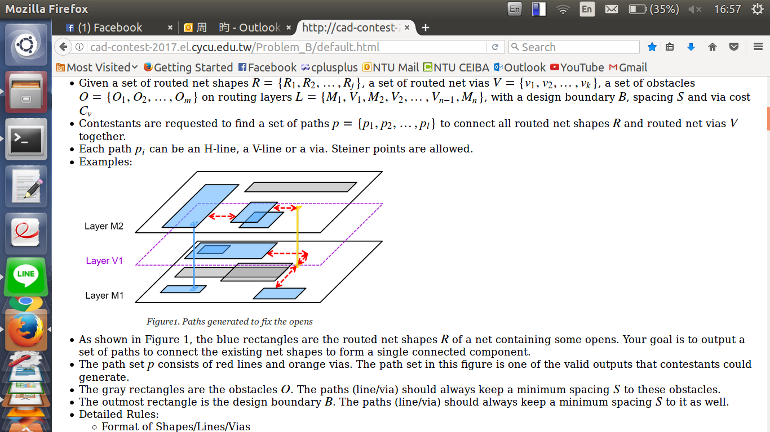
Goal
Connect all Shapes and Vias into one set with the minimum cost of the connections.

Slide 3
Main problems
* Finding shortest path for two distinguish points with or without obstacles between.
* Check for disjoint sets.
* Determine the closest point pair between two disjoint set.
* Avoid duplicated connection.
* Simplify the three-dimensional problem.

Slide 4
Others’ solution

Slide 5
Our solution
Scan for trivial connections.

Slide 6
Our solution
Minimum spanning tree.

Slide 7
Our solution
Hadlock’s Algorithm

Slide 8
Our solution
Multi-threading

Slide 9
Complexity

Slide 10
Improvement

Slide 11
Result

Slide 12
Discussion

